Slide 1


Slide 2
Digital Filter design and Implementation
Presented By:
Huzaifa Shahbaz (21-CE-009)

Slide 3
Outlines of Digital filter design
Abstract
Introduction
Objective
Expected Outcome
Methodology
Component used
Digital Filter Design
Finite Impulse Response
Infinite Impulse Response

Slide 4
Outlines of Digital filter design(continued)
Functional Requirements
Frequency Response Specifications
Filter Type Selection
Filter Order and Complexity
Stability and Robustness
Transition Bandwidth and Ripple
Phase Linearity
Implementation Constraints
Filter Optimization

Slide 5
Outlines of Digital filter design(continued)
Filtering Characteristics
Validation and testing
Non-functional Requirements
Performance
Scalability
Reliability
Robustness
Compatibility
Maintainability
Resource Efficiency

Slide 6
Outlines of Digital filter design(continued)
Usability
Portability
Compliance
Code
Kaiser window
Original Signal, Noisy Signal and Filtered Signal
Frequency Filtered Response
Conclusion

Slide 7
Abstract
In abstract, we discuss the digital filter design and implementation, distinguishing between finite impulse response(FIR) and infinite impulse response(IIR) filters and highlighting key design methods like windowing and optimization algorithms.
It highlights the use of software tools and their applications in audio, communications, and image processing.

Slide 8
Introduction
Developing algorithms to process digital signals and eliminate undesirable elements or enhance desired aspects while maintaining signal characteristics is known as digital filter design.
The impulse response of IIR filters is unlimited, whereas that of FIR filters is finite.
Windowing, frequency sampling, optimization techniques, and software tools are all used in implementation.
Image processing, telecommunication, and audio processing are examples of applications.

Slide 9
Objective
This technology improves signal quality, achieves desired frequency response, optimizes computational efficiency, ensures stability, facilitates parameter tuning, minimizes complexity, and integrates seamlessly into hardware and software platforms for practical deployment.

Slide 10
Expected Outcome
The goal of digital filter design and implementation is to use mathematical methods to obtain desired frequency response characteristics, such as low-pass, high-pass, band-pass, or band-stop.
The expected result is a filter with the desired frequency domain features, such as attenuation or amplification, within specified passbands and stopbands.
Implementation often entails programming the filter algorithm in a digital signal processing (DSP) platform or hardware to ensure efficient calculation and real-time performance.
The end product should show efficient suppression or isolation of specific frequencies while preserving others, thereby improving signal quality or extracting desired information.
Testing and validation compare the filter's performance to design specifications, verifying that it is appropriate for its intended uses, such as audio processing, image enhancement, or communication systems.

Slide 11
Expected Outcome(Continued)
Continuous refining and optimization can be performed to improve filter efficiency and minimize computational complexity, or adapt to changing requirements.

Slide 12
Methodology
To design a digital filter, define filter specifications, choose a filter type, design an analog prototype, apply frequency transformation, choose sampling frequency and discretization method, implement the digital filter, and verify performance through simulation and testing.

Slide 13
Component used
The components used of the digital filter design and implementation are following.
Spyder
Visual Studio Code

Slide 14
Digital Filter Design
A digital filter uses a digital processor to perform numerical calculations on sampled values of the signal.
The processor may be a general-purpose computer such as a PC, or a specialized DSP (Digital Signal Processor) chip.
There are the following types of digital filter design are
Finite Impulse Response
Infinite Impulse Response

Slide 15
Finite Impulse Response
Finite Impulse Response (FIR) filters are a type of digital filter characterized by a finite duration of their impulse response, settling to zero in a finite number of steps.
They exhibit linear phase response, making them suitable for applications requiring phase preservation.
Implementation involves convolution of the input signal with the filter coefficients.
The computational efficiency can be optimized using Fast Fourier Transform (FFT) techniques.
Validation ensures the filter meets performance criteria, providing the expected frequency response and minimal distortion.

Slide 16
Infinite Impulse Response
Infinite Impulse Response (IIR) filters are digital filters whose impulse response is theoretically infinite.
They are created using analog filter design approaches such as Butterworth, Chebyshev, or elliptic filters, and then converted to the digital domain using bilinear transformation or matching z-transform.
IIR filters use fewer coefficients than FIR filters to obtain comparable frequency response characteristics, making them more computationally efficient.
However, feedback can cause instability and nonlinear phase response.

Slide 17
Infinite Impulse Response(Continued)
Implementation entails recursive algorithms with outputs based on both current and previous input and output values.
Proper design and validation are required to assure stability and compliance with specified criteria.
Applications include audio processing, control systems, and communication.

Slide 18
Functional Requirements of digital filter design
The functional requirements of digital filter design are.
Frequency Response Specifications
Filter Type Selection
Filter Order and Complexity
Stability and Robustness
Transition Bandwidth and Ripple
Phase Linearity
Implementation Constraints
Filter Optimization
Filtering Characteristics
Validation and testing

Slide 19
Non-functional Requirements
The non-functional requirements of digital filter design are
Performance
Scalability
Reliability
Robustness
Compatibility
Maintainability
Resource Efficiency
Usability
Portability
Compliance

Slide 20
Code of digital filter design
import numpy as np
import matplotlib.pyplot as plt
from scipy.signal import hamming, lfilter, freqz
np.random.seed(0) # For reproducibility
fs = 700 # Sampling Frequency
t = np.linspace(0, 1.0, fs) # Time vector
freq1 = 10 # Frequency of the first sine wave
freq2 = 80 # Frequency of the second sine wave
clean_signal = np.sin(2 * np.pi * freq1 * t) + np.sin(2 * np.pi * freq2 * t)
# Add noise
noise = np.random.normal(0, 0.5, clean_signal.shape)
noisy_signal = clean_signal + noise

Slide 21
Code of digital filter design(continued)
# Step 2: Design the digital filter (low-pass FIR filter using window method)
cutoff = 10 # Desired cutoff frequency of the filter, Hz
nyquist = 0.5 * fs # Nyquist frequency
normal_cutoff = cutoff / nyquist # Normalized cutoff frequency
numtaps = 101 # Size of the FIR filter
# Use a Hamming window to design the filter
window = hamming(numtaps)
taps = np.sinc(2 * normal_cutoff * (np.arange(numtaps) - (numtaps - 1) / 2)) *window
taps /= np.sum(taps) # Normalize the filter coefficients
# Step 3: Apply the filter to the noisy signal

Slide 22
Code of digital filter design(Continued
filtered_signal = lfilter(taps, 1.0, noisy_signal)
# Step 4: Plot the results
plt.figure(figsize=(15, 10))
# Original signal
plt.subplot(3, 1, 1)
plt.plot(t, clean_signal)
plt.title('Original Signal')
plt.xlabel('Time [seconds]')
plt.ylabel('Amplitude’)
# Plot frequency response of the filter
w, h = freqz(taps, worN=8000)

Slide 23
Code of digital filter design(Continued
plt.figure()
plt.plot(0.5 * fs * w / np.pi, np.abs(h), 'b')
plt.title('Filter Frequency Response')
plt.xlabel('Frequency [Hz]')
plt.ylabel('Gain')
plt.grid()
plt.show()

Slide 24
Kaiser Window
It is a one-parameter family of window functions used in finite impulse response filter design and spectral analysis.
The Kaiser window approximates the Diode Pumped Solid State (DPSS) window which maximizes the energy concentration in the main lobe but which is difficult to compute.

Slide 25
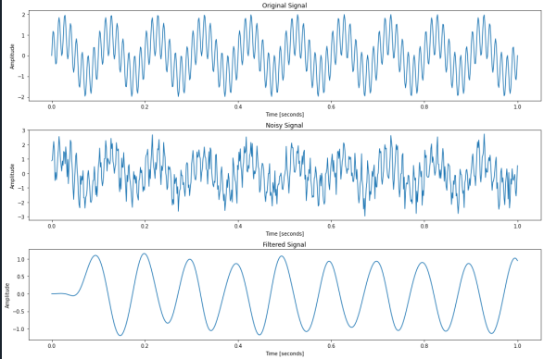
Results and graphs of Original Signal, Noisy Signal and Filtered Signal

Slide 26
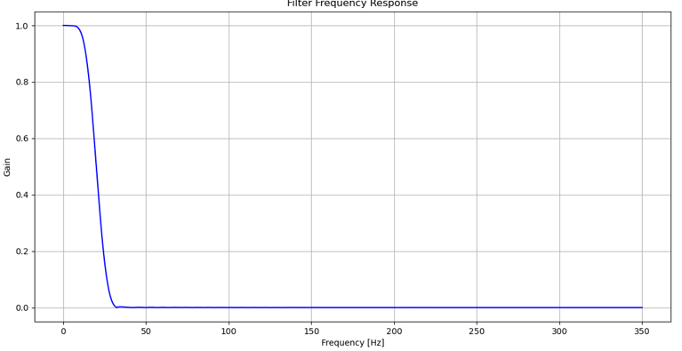
Results and graphs of Filter Frequency Response

Slide 27
Conclusion
In conclusion, this work gave a thorough approach to digital filter design, including both theoretical and practical aspects.
The approach used to develop both Finite Impulse Response (FIR) and Infinite Impulse Response (IIR) filters was described, with a focus on their functional and non-functional needs.
The Kaiser Window approach was recognized as an efficient way to improve filter performance.
Several tests were conducted to confirm the implementation, demonstrating the filter's capacity to effectively reduce noise while keeping signal integrity.
The findings and graphs gave a clear visual representation of the filter's performance, verifying the design's success.

